Slide 1
Team - KTPR-sqad
Team ID - EV26
PS02 – AI-POWERED EARLY RISK PREDICTION FOR PATIENT HEALTH CONDITIONS

Slide 2
  Healthcare systems generate large volumes of patient health data
  Many serious diseases develop silently, showing symptoms only at later stages
  Traditional rule-based and manual screening systems fail to detect early risk patterns
  Delayed detection leads to poor health outcomes and increased treatment costs
  There is a need for an AI-based system that can identify health risks early using patient data
PS Overview

Slide 3
Visualization for Insights on Model
Purpose of Visualization
  To understand data patterns and feature behavior
  To identify relationships between medical parameters and disease risk
  To validate model learning and improve interpretability
Visualizations Used
  Bar charts to analyze disease distribution and outcomes
  Correlation heatmaps to study relationships between medical features
  Feature importance plots to identify key risk factors
  Input vs prediction trend graphs for risk interpretation
Insights Gained
  Certain medical parameters strongly influence disease risk
  Feature patterns vary significantly across diseases
  Visualization improves trust and transparency in ML predictions

Slide 4
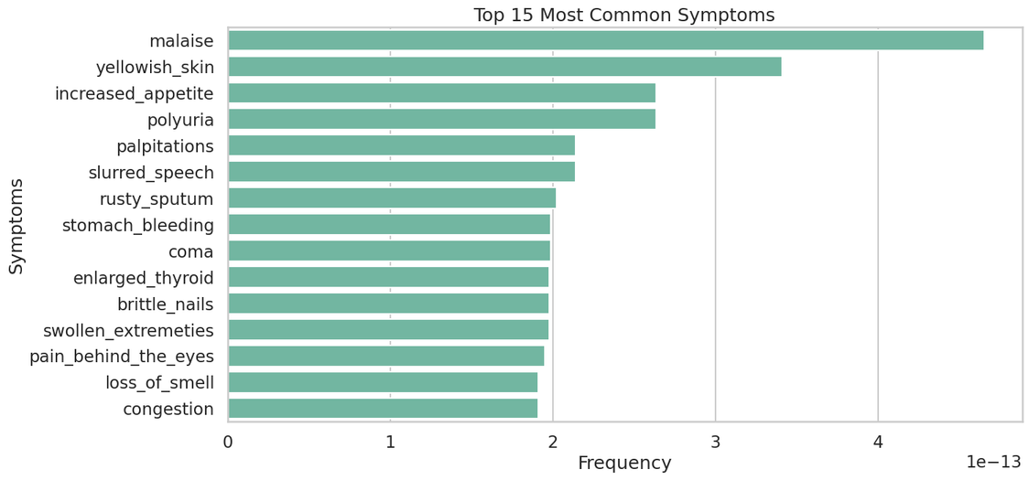
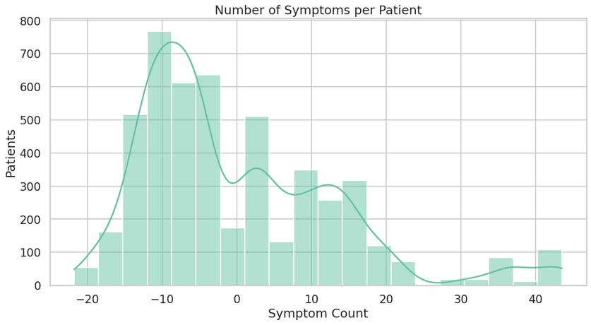
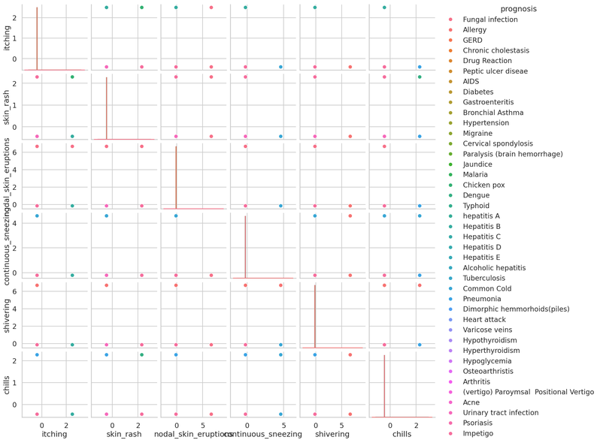
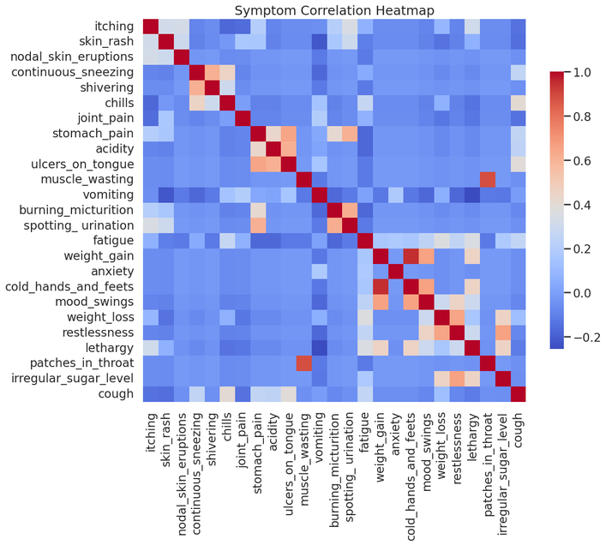
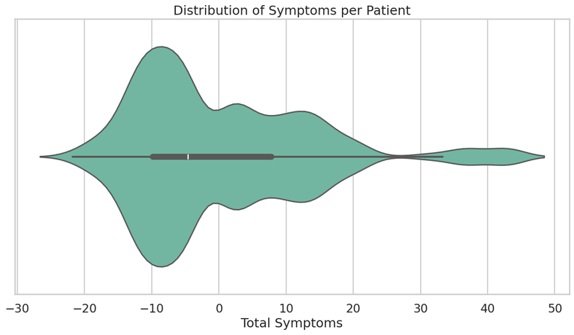
Data Visualisation

Slide 5
Solution Overview
  Developed an AI-powered early risk prediction system using machine learning
  Built disease-specific ML models for high-impact diseases such as: Diabetes, Heart Disease, Parkinson’s, Anemia, Dermatological conditions
  The system acts as an early risk screening tool, not a diagnostic replacement
Solution Approach
  Collected and cleaned disease-specific healthcare datasets
  Selected medically relevant features for each disease
  Trained separate supervised ML models for each condition
  Integrated all models into a single unified web application
  Users input health parameters and receive early risk predictions
Why This Works
  Disease-specific models improve accuracy
  Early risk detection supports preventive care
  Modular design allows easy addition of new diseases
Proposed ML Solution

Slide 6
DATA SOURCE
IDE USED
Public healthcare datasets from:
  Government health portals
  WHO-linked and research datasets
  UCI-based and validated GitHub repositories
  Real medical parameters used for training
  Disease-specific datasets used due to lack of unified Indian patient data
  Google Colab
  Power BI
TOOLS USED
  Python and its Libraries - for preprossessing
  ML - Scikit learn

Slide 7
Thank You!
For your listening...

